Slide 1
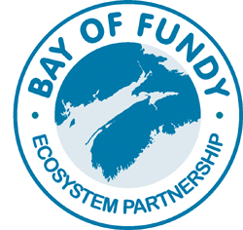
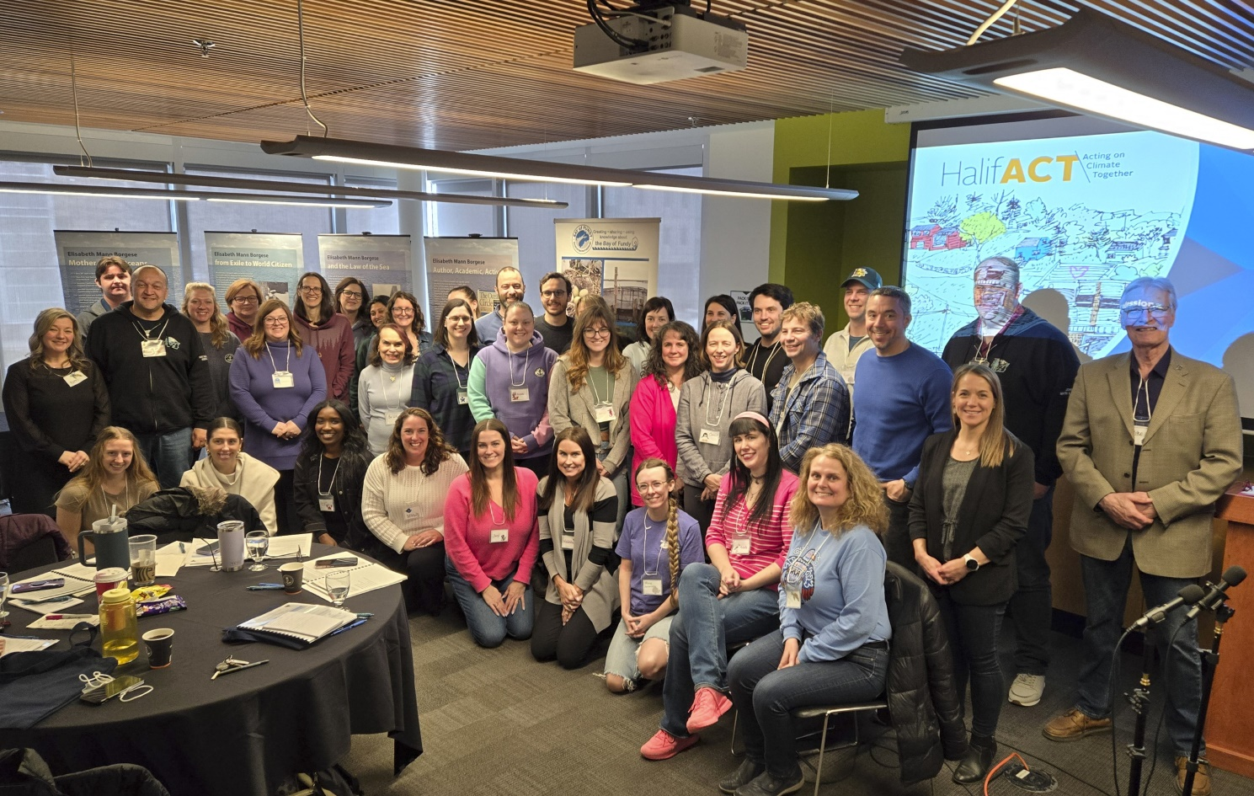
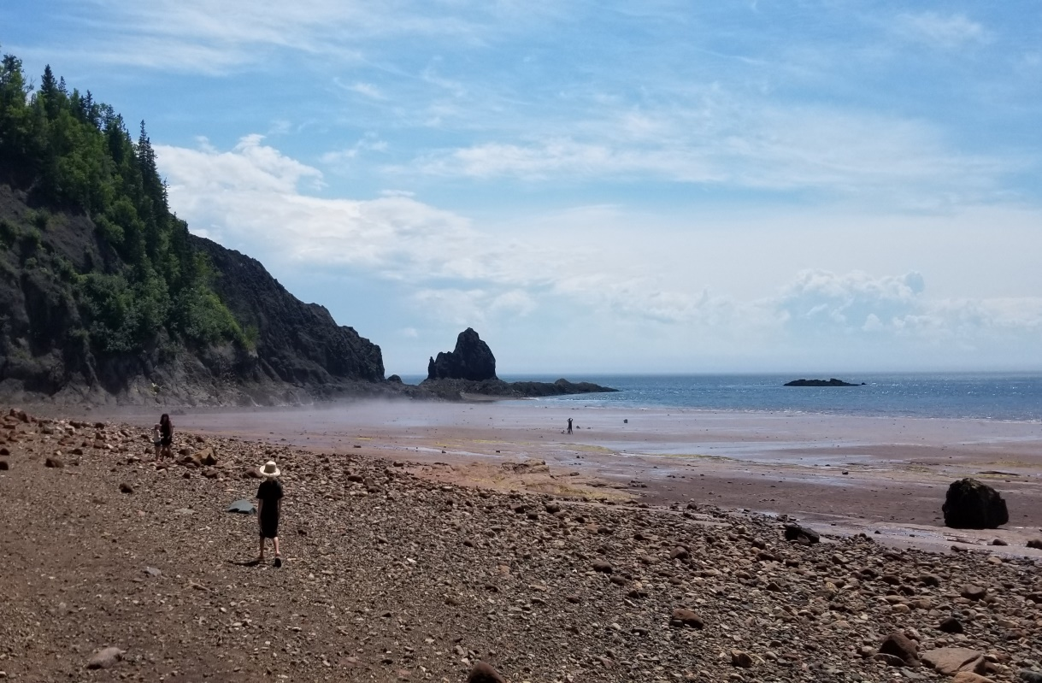
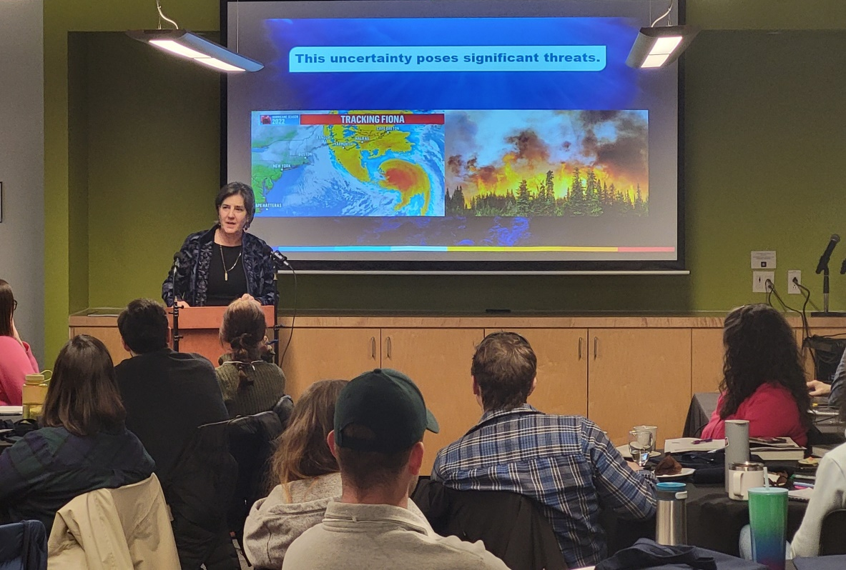
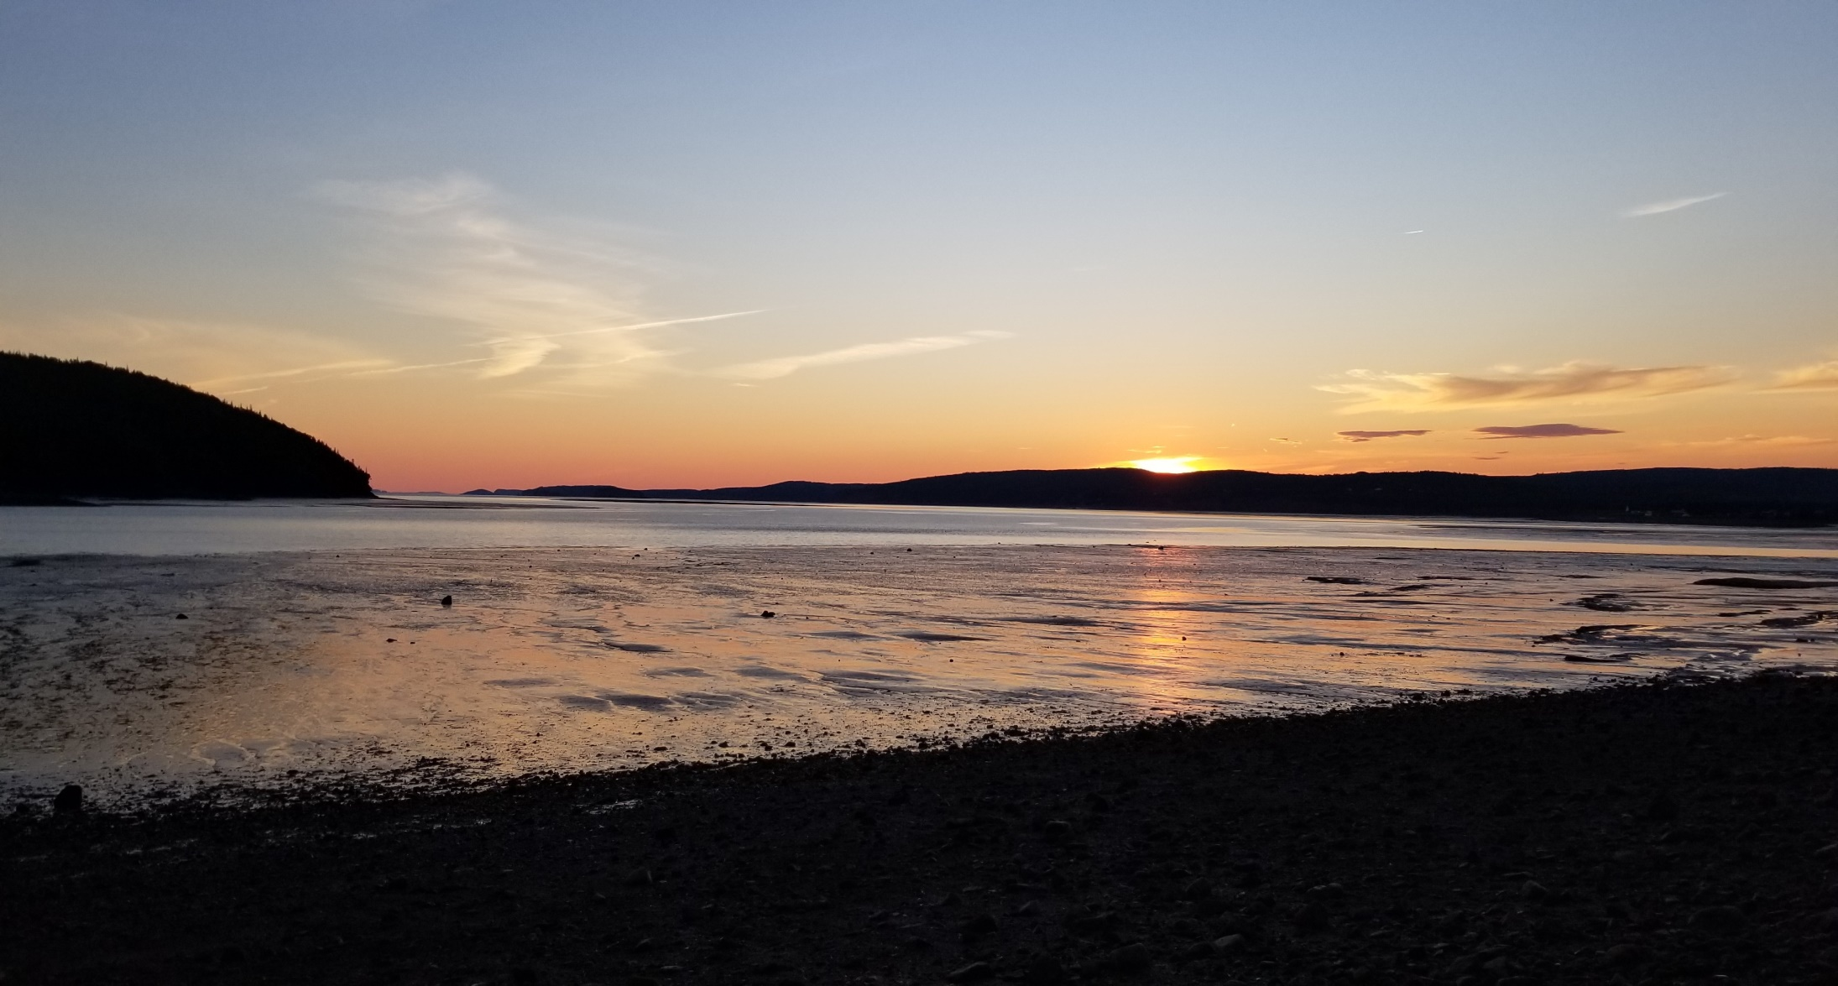
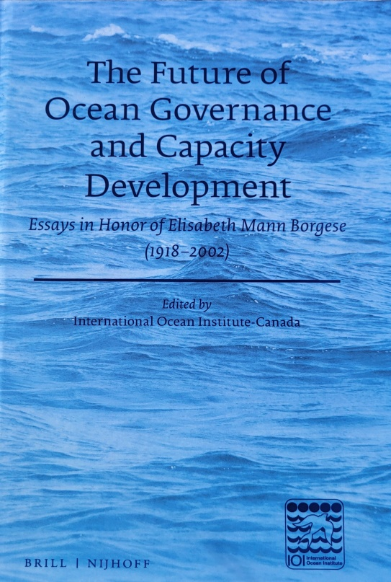
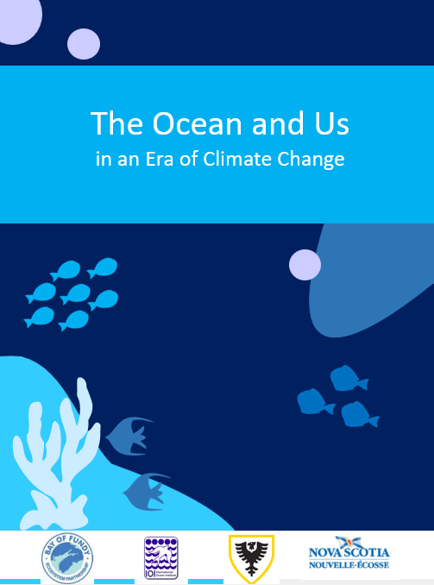
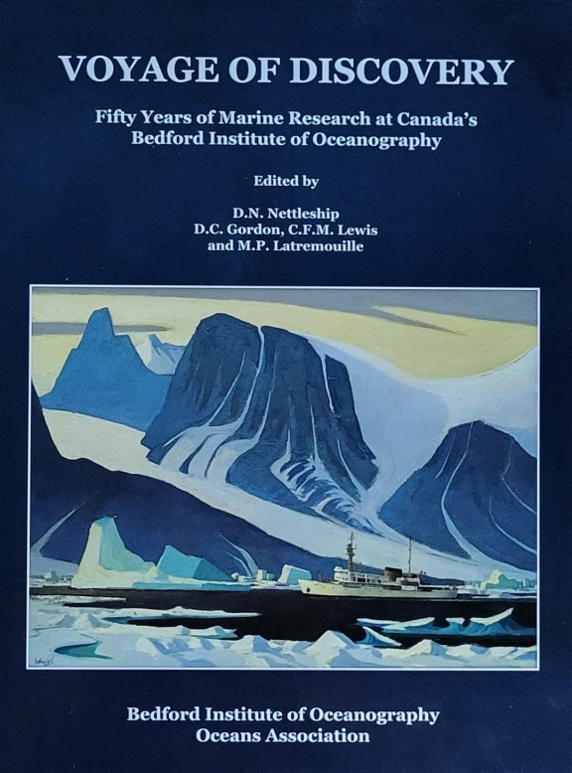
ENHANCING OCEAN LITERACY IN THE FUNDY COMMUNITY: CONTINUED ACTIVITIES OF BOFEP’S OCEAN LITERACY WORKING GROUP
M.J.A. Butler, K. MacPherson, S. Rebitt, and P.G. Wells
Affiliations: International Oceans Institute-Canada, NS Department of Education and Early Childhood Development, and Dalhousie University
OVERVIEW
OUR PROGRESS
NEXT STEPS
BoFEP strives to provide communication and education about the environmental issues and challenges facing the Bay of Fundy, Gulf of Maine, and its watersheds. This is achieved through:
A working group (WG) focused on Ocean Literacy (OL); OL can be defined as “understanding the ocean and our relationship to it” (CaNOE, Canadian Network for Ocean Education).
A focus on informing the public, especially younger generations who will be most impacted by climate change and its relationship with the ocean.
Aligning with the goals of national and international leaders in OL, including COLC (Canadian Ocean Literacy Coalition), CaNOE and the Programs of UNESCO’s Intergovernmental Oceanographic Commission (IOC).
Ocean Literacy panels were organized at the biennial BoFEP workshops in 2020, 2022 and 2024 to discuss and report on OL; these were followed by numerous off-grid discussions and presentations.
Consider the appropriate steps forward to further ocean literacy in the school systems, based on the experience of the OL panels at previous BoFEP workshops and feedback from the PD Day.
Continue to strengthen the linkage between organizations promoting OL including COLC, CaNOE, Ocean Wise, Ocean School, citizen science initiatives, and the NS Department of Education.
Engage relevant university faculties of education (Acadia, MSVU, CBU, StFX etc.) on how to include OL training in the B.Ed and M.Ed degree programs, including short term courses.
The International Oceans Institute (IOI) – Canada, in collaboration with BoFEP and the NS Department of Education, organized the first Professional Development (PD) Day on the ocean/climate nexus. This was primarily for high school teachers and was delivered in March 2024 at Dalhousie University. The session included:
Guest speakers from HRM, Dalhousie University, CLIMAtlantic, PIER, and IOI-Canada discussing climate change fundamentals, the role of the ocean in climate change, health of the ocean and us, global responses, the blue economy, and the HRM’s plans in response to climate change.
Suitable ocean-resource materials and resources were integrated into a tool kit and distributed to teachers; other resources were on display.
OCEAN LITERACY OBJECTIVES
Identify the most appropriate ways and means to introduce the ocean/climate topic into the public school system.
Prepare grade-appropriate resources including books, scientific papers, classroom exercises, and field trips.
Provide information about the uniqueness of the Bay of Fundy’s environment to local communities. For example, through BoFEP’s monthly newsletter, Fundy Tidings, and a soon to be published interactive book on the Minas basin.
INVITATIONS
Members of the Fundy coastal community are invited to join the BoFEP Ocean Literacy working group. Their participation will directly contribute to the important task of improving public understanding of ocean literacy within the context of climate change and the unique Bay of Fundy ecosystem.
BoFEP Website: https://www.bofep.org/ | Facebook: Bay of Fundy Ecosystem Partnership | Twitter: @BayofFundyEP

